Slide 1

AlterNative
Make your applications become native

Slide 2
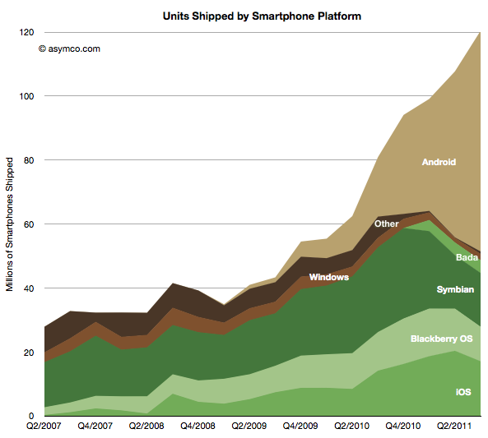

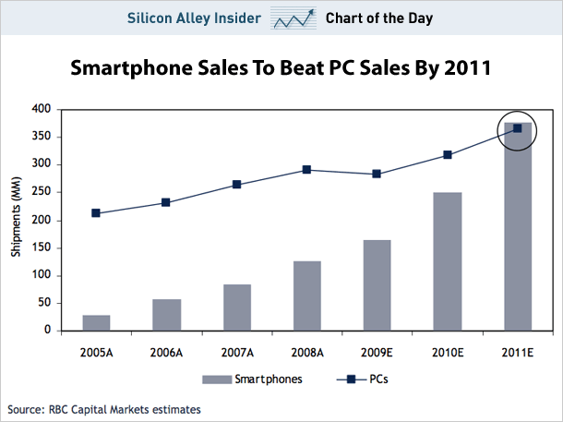
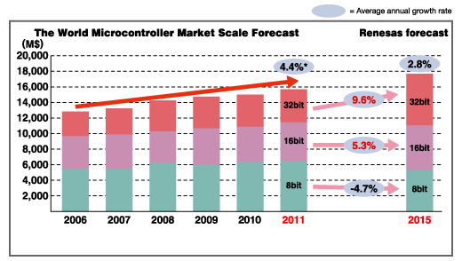
IoT & Devices market

Slide 3
Concept
Unix
Android
Linux
Microsoft
Windows
Apple
Mac
iOS
Embedded systems
C++

Slide 4
Use cases
Improves performance and portability on:
Mobile
Android
iOS
Windows Phone
Embedded systems
MicroFramework
Linux
Computers
Mac
Windows
Linux

Slide 5
Soa Summary
Mobile development tolos
PhoneGap (and HTML/JS dev tools)
Decompilers
ILSpy
Decompilers to IL
Decompilers
Translators
C# → JavaScript (i.e. Script#)
Web languages
.NET Native
C++ back-end compiler for .NET to native

Slide 6
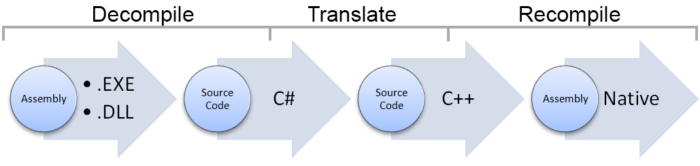
Process

Slide 7
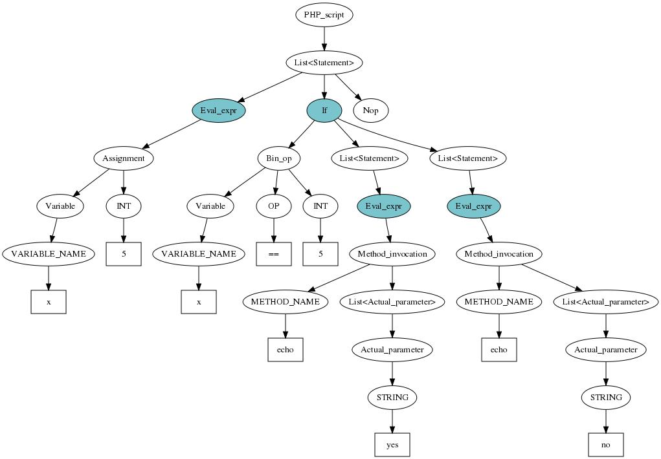
AST
Abstract Syntax Tree
Tree representation of source code
Related with the language

Slide 8
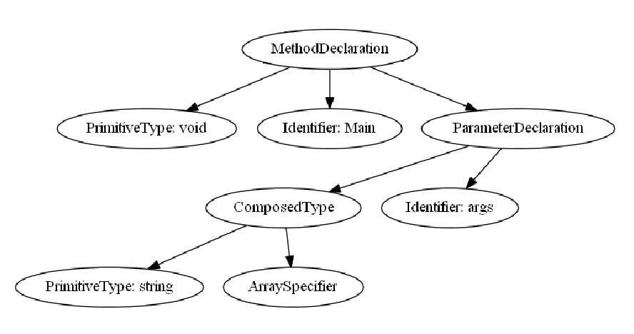
AST example Csharp

Slide 9
General scheme
Load Assembly
CECIL Library
AST Builder
C# AST
C++ AST
C# Output Visitor
C++ Output Visitor
C# Language text output
C++ Language text output
C# to C++ Output Visitor

Slide 10
Example translation C# -> C++
void Main(string[] args){
}
void Main(String args[]){
}

Slide 11
Example AST transformation
Composed Identifier
void Main(string[] args){
}
void Main(string args[]){
}

Slide 12
Features
Loops (while, for, foreach)
Classes, inheritance, nested classes
Generics
Type conversions and Casting
Explicit
Implicit
Events & Delegates
Threads
Timers
Files
Exceptions
First memory management
Network

Slide 13
Tools
Compilers
MSbuild
GCC / Clang → C++11
Linux
Android arm
Raspberry arm
Cross-platform tools
CMake
Test tools
Proprietary: RegressionTest
Libraries
Boost
Boehm gc
AlterNative
Patches
Boost for android
Boehmgc for android

Slide 14
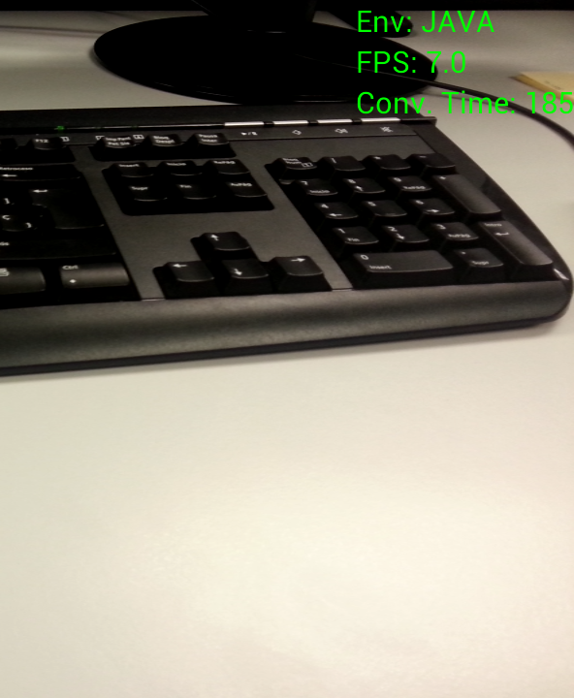
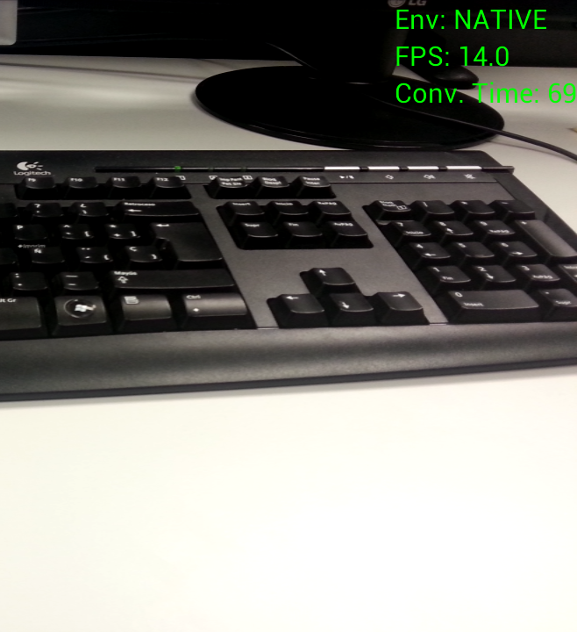
Mobile Test
Image processing
Vs.

Slide 15
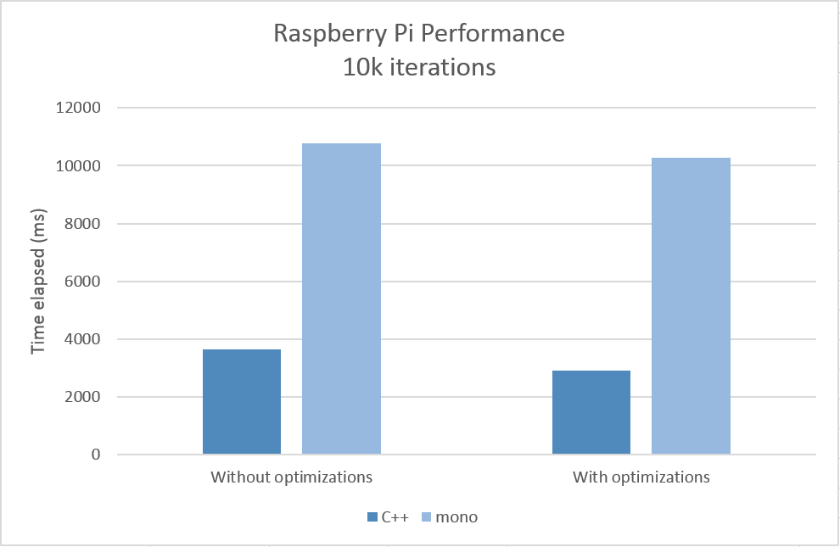
Embedded test
Raspberry
C++ vs Mono

Slide 16
Computer tests
Performance CPU tests

Slide 17
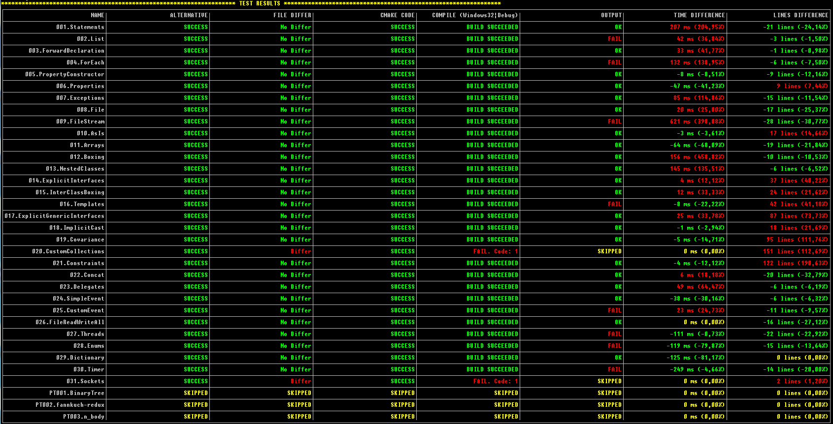
Testing – Regression Test

Slide 18
Future – Next steps
Library
Network
Introspection
Examples
Autopilot
ICARUS Image processing
Compile all tests in all platforms
Continuous integration server
Tutorial and docs for GitHub

Slide 19

Thank You
Code on:
Translator:
https://github.com/AlexAlbala/Alter-Native
Library
https://github.com/AlexAlbala/AlterNative-CXX-Lib
https://github.com/AlexAlbala/AlterNative-CXX-pvtLib
Tests
https://github.com/AlexAlbala/AlterNative-Tests

